Slide 1


Anas Aamoum
12/03/2023

Slide 2

Outline
Executive Summary
Introduction
Methodology
Results
Conclusion
Appendix

Slide 3
Executive Summary
Summary of methodologies
Data collection
Data Wrangling
EDA with data visualization
EDA with SQL
Interactive map with Folium
Dashboard with Plotly Dash
Predictive analysis
Summary of all results
EDA results
Interactive analysis (Plotly)
Predictive analysis results

Slide 4
Introduction
Project background and context
Space X advertises Falcon 9 rocket launches on its website with a cost of 62 million dollars; other providers cost upward of 165 million dollars each, much of the savings is because Space X can reuse the first stage. Therefore if we can determine if the first stage will land, we can determine the cost of a launch. This information can be used by our company Space-Y so that we can bid against space X for a rocket launch.
Problems you want to find answers
Predict whether the first stage of the Falcon 9 rocket will land successfully.

Slide 5

Section 1

Slide 6
Methodology
Executive Summary
Data collection methodology:
SpaceX Rest API
Web Scrapping from the Wikipedia page of Space X launches
Perform data wrangling
Data was processed using one hot encoding for categorical features
Perform exploratory data analysis (EDA) using visualization and SQL
Perform interactive visual analytics using Folium and Plotly Dash
Perform predictive analysis using classification models
Several models were built and evaluated: Linear Regression, KNN, SVM, Decision Tree

Slide 7
Data Collection
Data about Space X launches was request from the Space X API.
The HTTP response was converted to a JSON object.
The information contained in the JSON included: rocket, payload mass, success/fail, etc…
The information was then converted to a dataframe and saved to a csv.
Another way used to collect data is by scraping data from Wikipedia using BeautifulSoup.

Slide 8
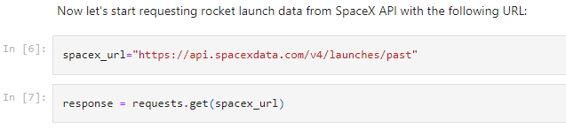
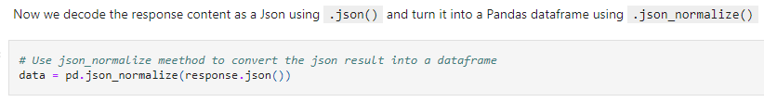

Data Collection – SpaceX API
1- GET request to endpoint:
2- Transform JSON to Dataframe
3- Clean data (check notebook 13-28)
4- Export to CSV
Data collection from the Space X REST API
Notebook : click to open Data-Collection-Jupyter-Notebook

Slide 9
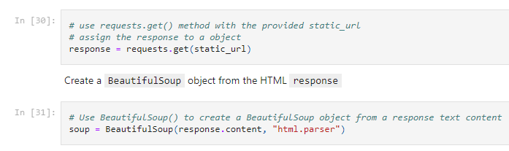
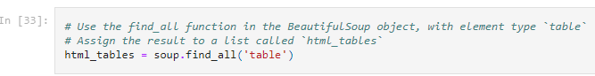
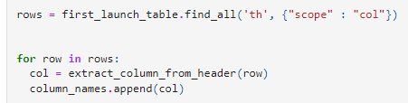
Data Collection - Scraping
1- GET request and receive a HTML response. Then, make a soup of it:
2- Find the tables
3- Get column names
4
4- Create the dataframe
5- Export the dataframe to csv
Collect data by web scrapping from Wikipedia
Notebook : click to open Web scrapping notebook

Slide 10
Data Wrangling
Check null values
Calculate number of launches on each site
Calculate the number and occurrence of each orbit
Calculate the number and occurrence of mission outcome per orbit type
Create a landing outcome label from Outcome column
Notebook : click to open Data wrangling notebook

Slide 11
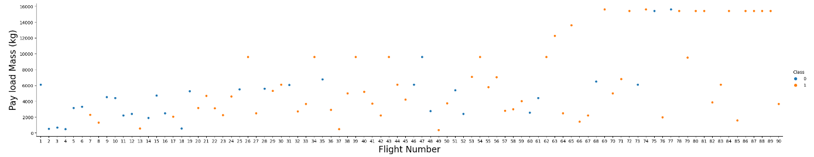
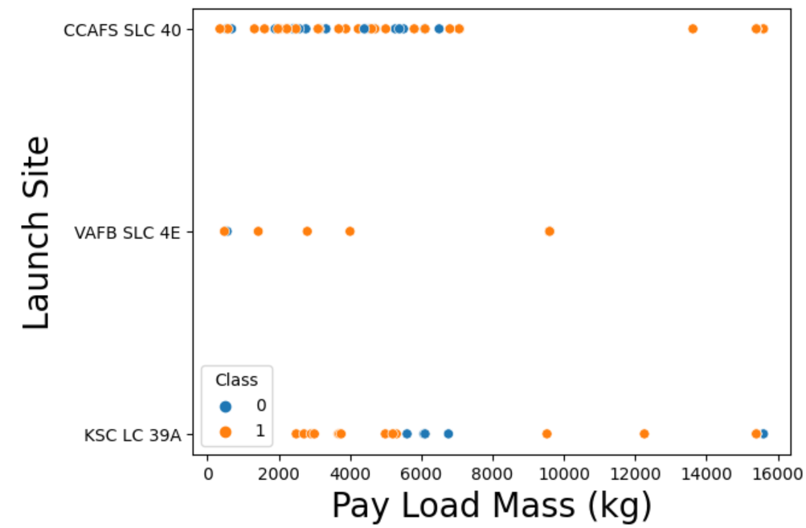
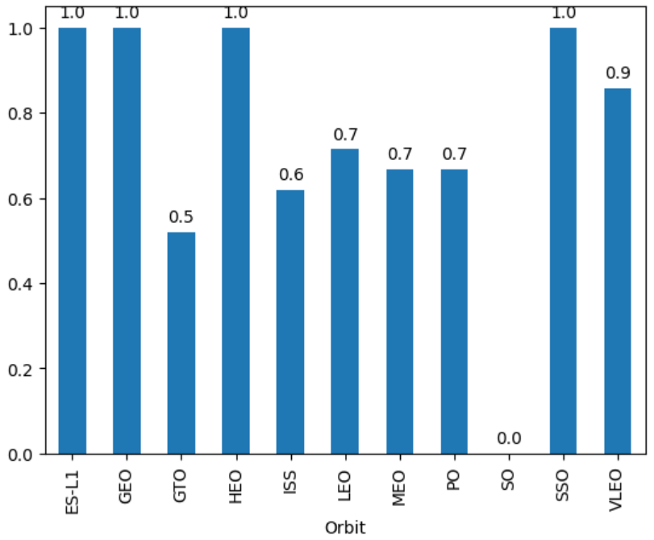
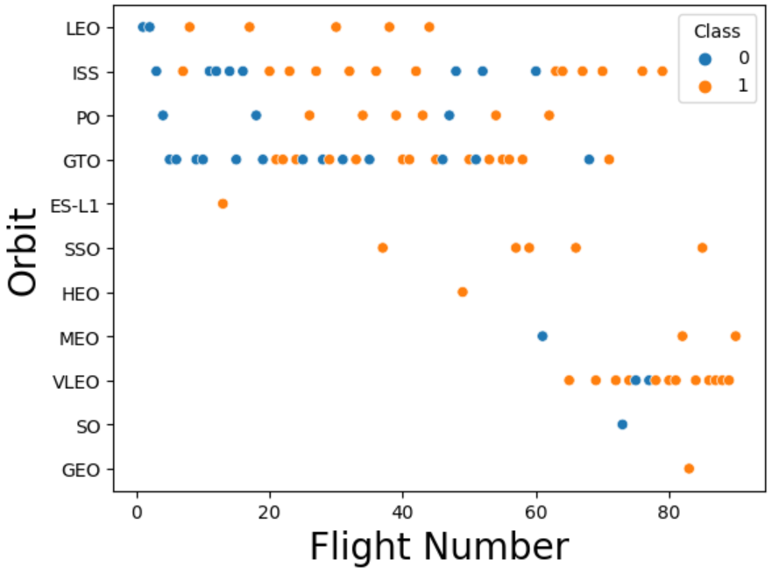
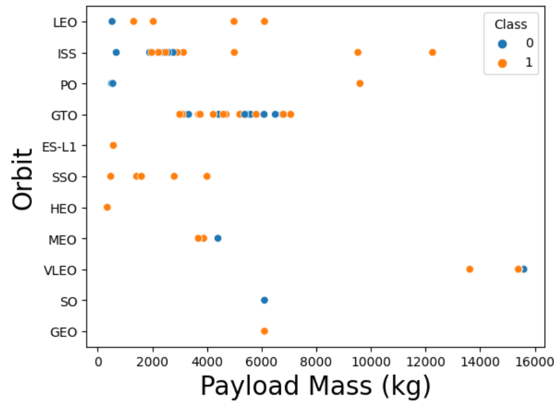
EDA with Data Visualization
Notebook : click to open Data visualization notebook

Slide 12
EDA with SQL
SQL queries performed:
Display the names of the unique launch sites in the space mission
Display 5 records where launch sites begin with the string 'CCA’
Display the total payload mass carried by boosters launched by NASA (CRS)
Display average payload mass carried by booster version F9 v1.1
List the date when the first successful landing outcome in ground pad was achieved
List the names of the boosters which have success in drone ship and have payload mass greater than 4000 but less than 6000
List the total number of successful and failure mission outcomes
List the names of the booster_versions which have carried the maximum payload mass. Use a subquery
List the records which will display the month names, failure landing_outcomes in drone ship ,booster versions, launch_site for the months in year 2015
Rank the count of successful landing_outcomes between the date 04-06-2010 and 20-03-2017 in descending order
Notebook : click to open EDA with SQL notebook

Slide 13
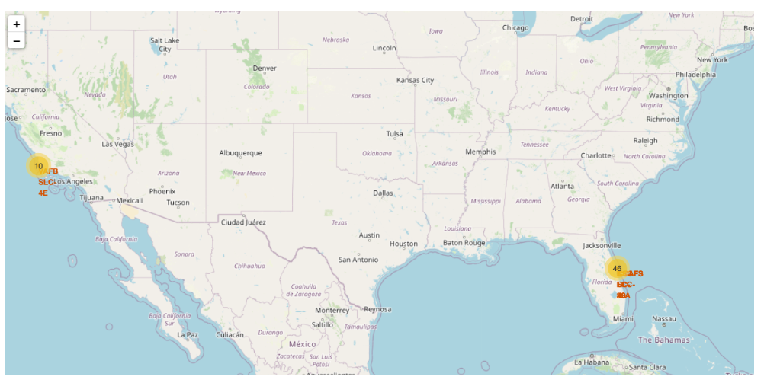
Build an Interactive Map with Folium
Map markers added in order to help in finding the optimal location for a launch site.
Notebook : click to open Folium map notebook

Slide 14
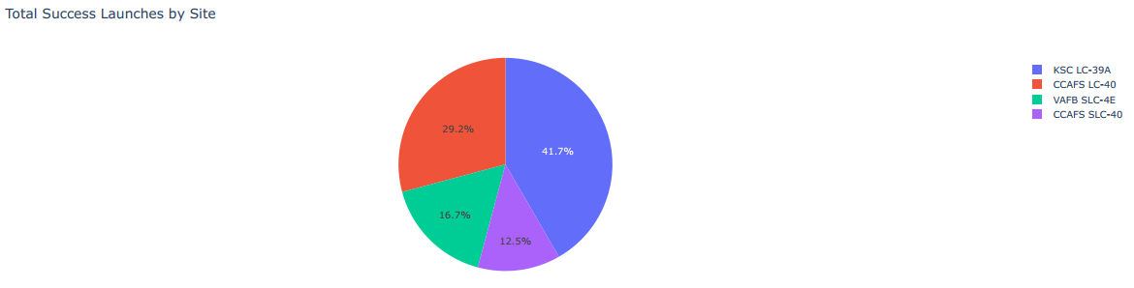
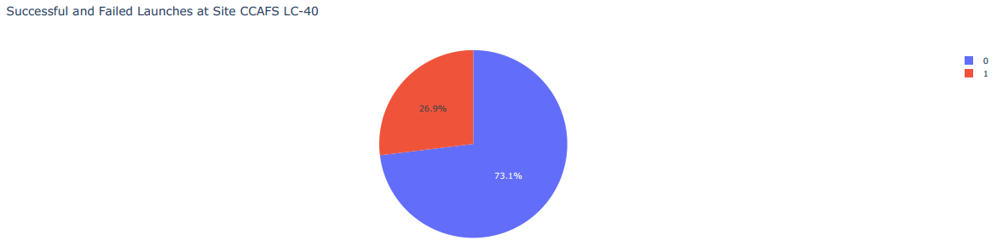
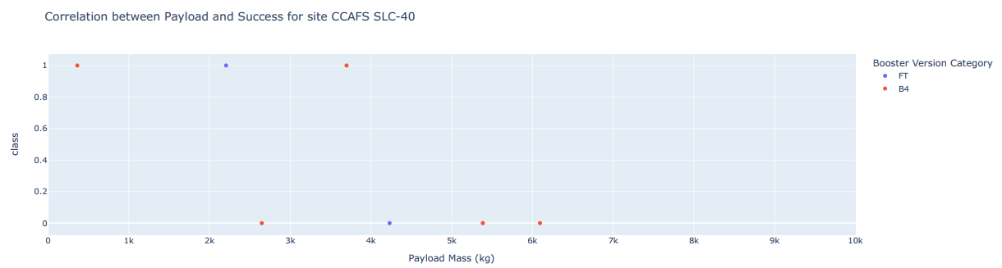
Build a Dashboard with Plotly Dash
Python Script : click to open Plotly Dashboard
This plot shows the how successful launches were split among launch sites.
CCAFS LC-40 had 73.1% successful launches

Slide 15
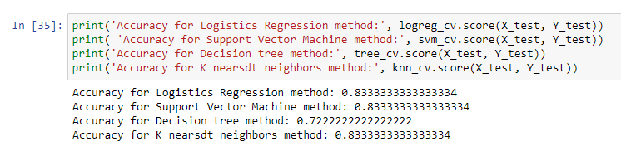
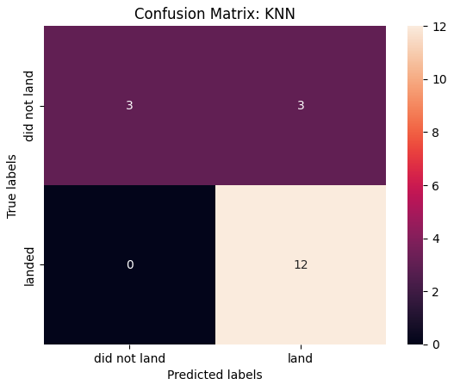
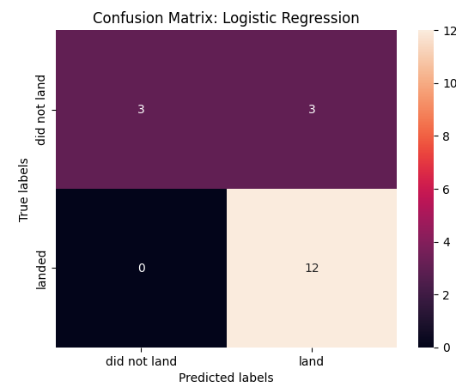
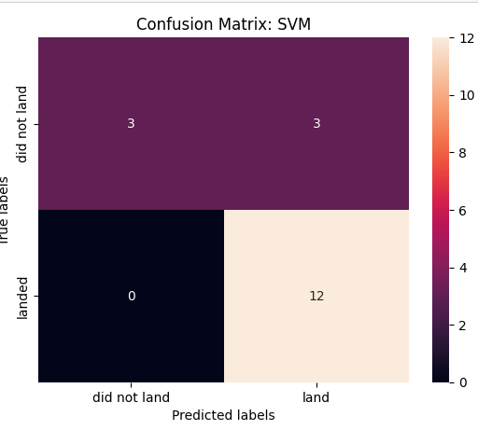
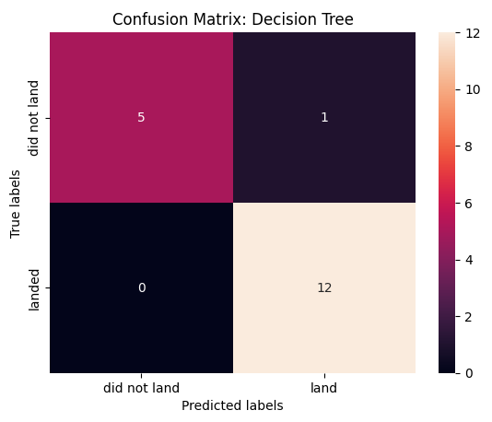
Predictive Analysis (Classification)
4 models were built: SVM, KNN, LR and DT. The accuracy of each model on the test set was calculated.

Slide 16
Results
SVM, KNN and logistic regression have performed the best in predicting the outcome of a launch. The decision trees performed the worst.
The success rate increased with the years. The payload also increased with the years.
Orbits GEO, HEO, SSO and ES L1 have the best success rate of launching.

Slide 17

Section 2

Slide 18
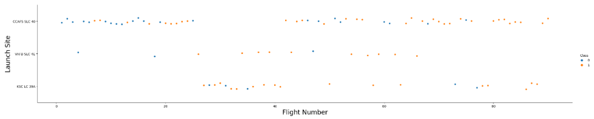
Flight Number vs. Launch Site
Most of the initial launches happened in CCAFS SLC 40.
Most of the initial launches were unsuccessful.

Slide 19
Payload vs. Launch Site
High payload launches took place in CCAFS SLC 40 and KSC LC 39A

Slide 20
Success Rate vs. Orbit Type
Orbits GEO, HEO, SSO and ES L1 have the best success rate of launching.
GTO and SO orbits have the lowest success rate.

Slide 21
Flight Number vs. Orbit Type
Some orbits have happened only in the recent years: VLEO, SO, GEO, MEO.

Slide 22
Payload vs. Orbit Type
Some orbits have either heavy payloads or light payloads.
Example: VLEO orbits has heavy payloads while SSO orbit has light payloads.

Slide 23
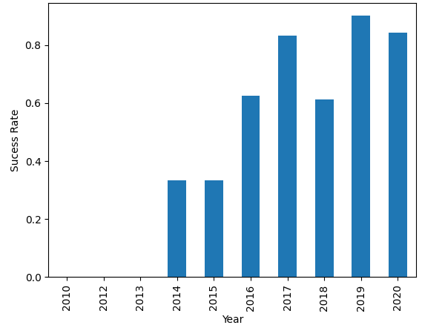
Launch Success Yearly Trend
Succes rate generally kept increasing with the years.

Slide 24
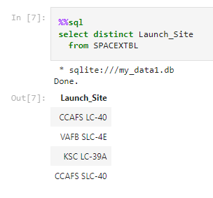
All Launch Site Names
The query selects the name of launch site with the keyword `distinct` to get the names once.

Slide 25
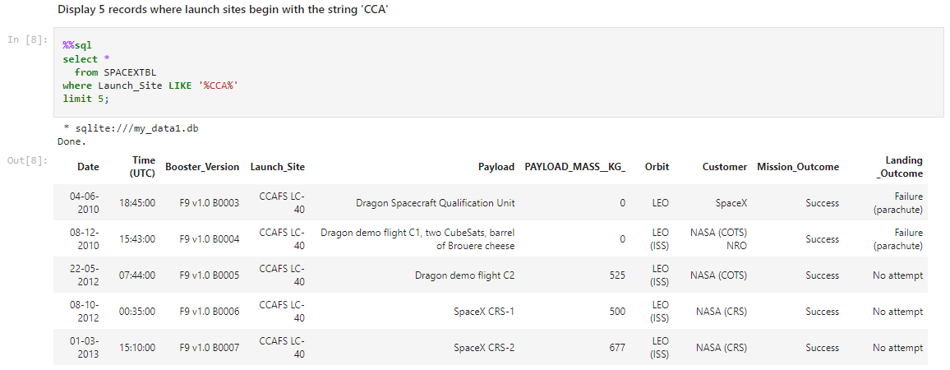
Launch Site Names Begin with 'CCA'

Slide 26
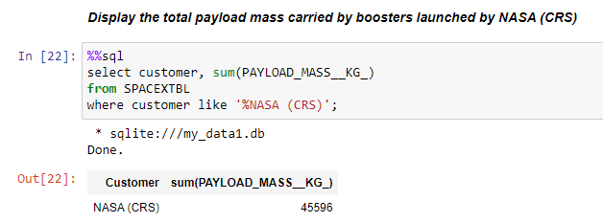
Total Payload Mass

Slide 27
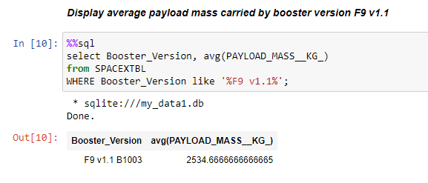
Average Payload Mass by F9 v1.1

Slide 28
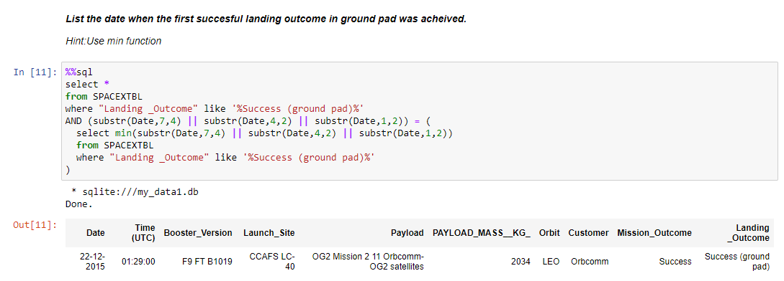
First Successful Ground Landing Date
First successful ground landing was on 22/12/2015

Slide 29
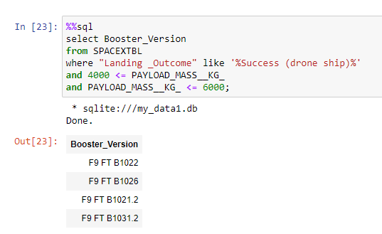
Successful Drone Ship Landing with Payload between 4000 and 6000

Slide 30
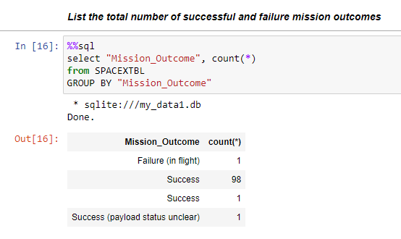
Total Number of Successful and Failure Mission Outcomes

Slide 31
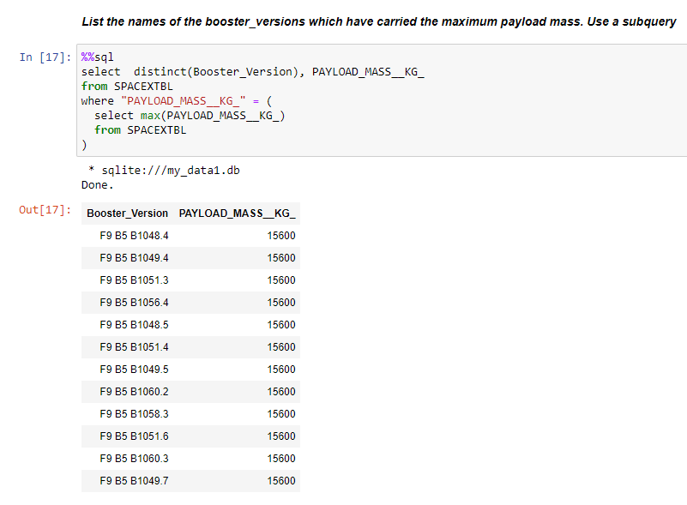
Boosters Carried Maximum Payload

Slide 32
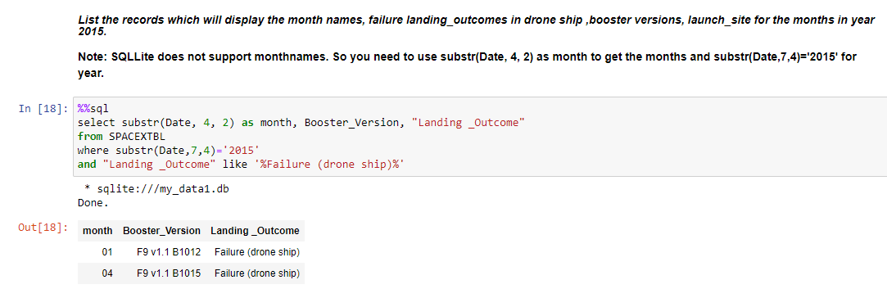
2015 Launch Records

Slide 33
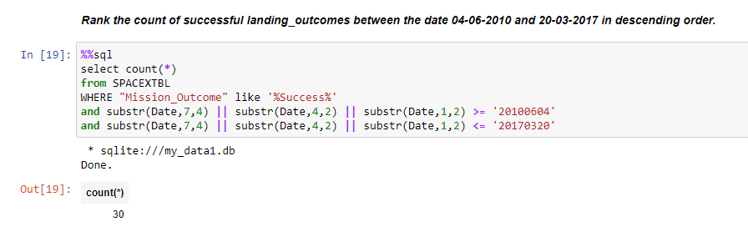
Rank Landing Outcomes Between 2010-06-04 and 2017-03-20

Slide 34

Section 3

Slide 35
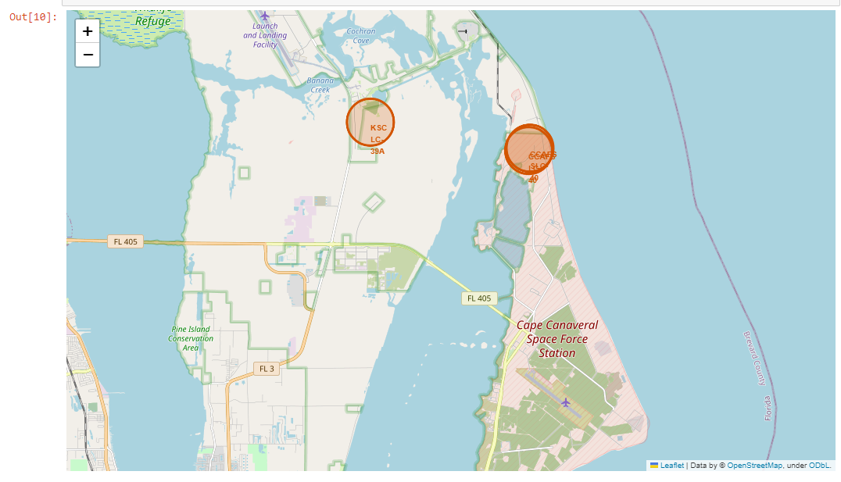
Launch site marked on a map
3 launch sites on the east coast

Slide 36
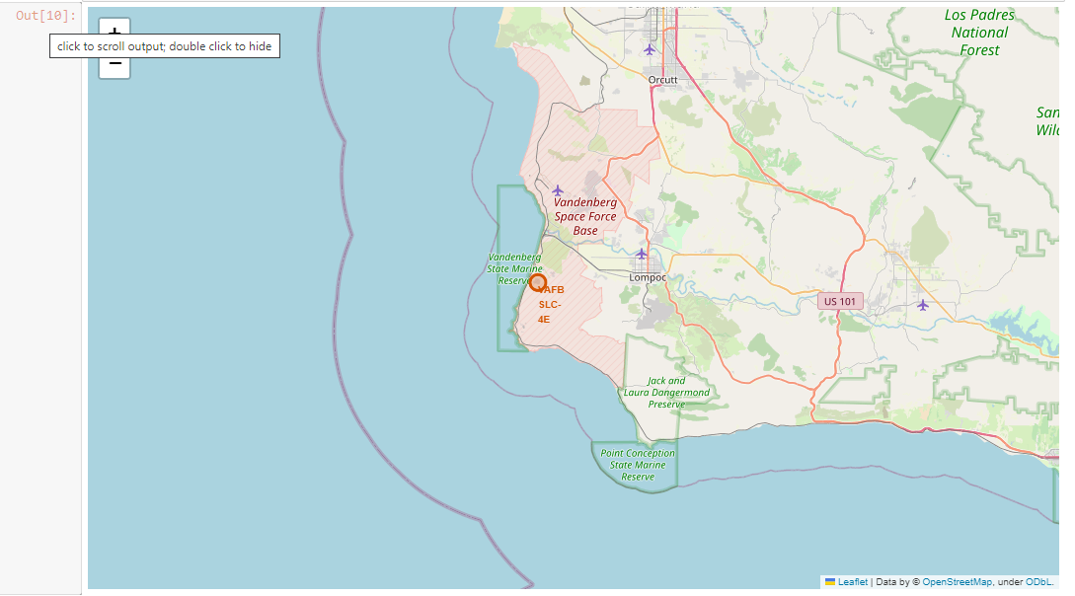
Launch site marked on a map
1 launch site on the west coast

Slide 37
Launch sites, Explanation
The launch sites are close to the equator line since it requires less energy to send a rocket to space the closer the launch site is to the equator.
The launch site are near the coast for safety reasons.
Launch sites are close to railways in order to be able to transport cargo needed to the site.
Launch sites are close to highways in order to be able to transport personnel
Launch sites are far from cities for safety reasons.

Slide 38

Section 4

Slide 39
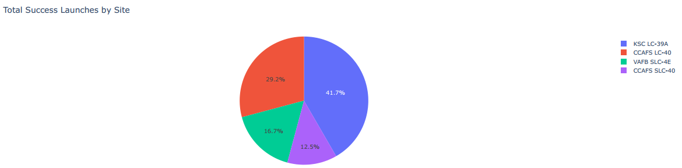
Success launches among launch sites
Most launch sites happened in KSC LC-39A

Slide 40

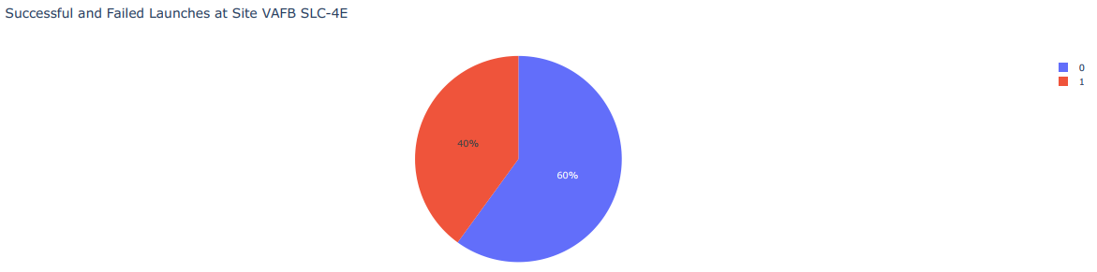
Success / Failure by launch site

Slide 41
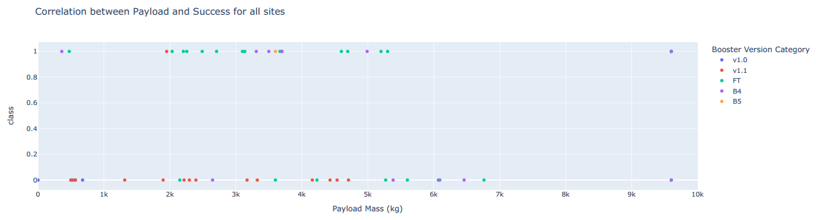
Launch outcome Vs. Payload

Slide 42

Section 5

Slide 43
Classification Accuracy

Slide 44
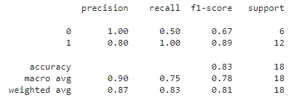
Confusion Matrix
The highest accuracy achieved among all models was 83%

Slide 45
Conclusions
SVM, KNN and logistic regression have performed the best in predicting the outcome of a launch. The decision trees performed the worst.
The success rate increased with the years. The payload also increased with the years.
Orbits GEO, HEO, SSO and ES L1 have the best success rate of launching.

Slide 46
Appendix
All Jupyter notebooks, Python scripts and CSV files are in the following GitHub repository:
https://github.com/anasLearn/data-science-capstone

Slide 47


